Slide 1
ME 309: Instrumentation and Controls Systems
Smart Camera System for Real-Time Driver Drowsiness Detection
Team 5
Sidhwa Tanuj Haresh 230003073
Sri Varsha Dodda 230003074
Jairaj Lad 230003029
Koyna Pandit 230003034
Dodiya Monik 230003022

Slide 2
Introduction
Driver fatigue and drowsiness are among the leading causes of road accidents worldwide. Despite existing solutions like seat vibration alerts or simple lane departure warnings, these systems often fail to take immediate corrective action when a driver is unresponsive. There is a need for a low-cost, vision-based system that can continuously monitor driver alertness and, upon detecting drowsiness or inattention, autonomously activate safety mechanisms to prevent accidents.

Slide 3
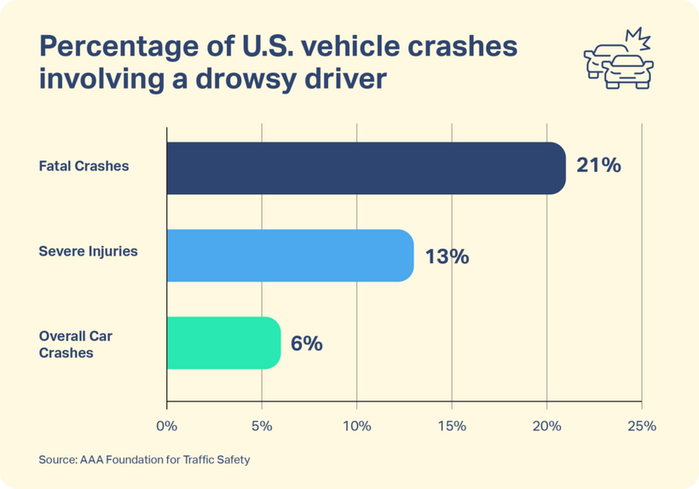
Real World Perspective
  Drowsy driving factor: Drowsy driving causes over 20% of global road accidents, especially during night and long trips, stressing the need for better detection systems.
  Fatalities and injuries: Fatigue-related inattention accounts for about 20% of annual road fatalities and serious injuries, underscoring the importance of detection systems.
  Economic and social impact: Fatigue-related crashes cost billions in medical care, productivity loss, and insurance, while inflicting severe social and emotional burdens on families

Slide 4

Objectives
Objective 01
Objective 02
Objective 03
Detect eye closure and yawning in real-time using webcam.
Send corresponding signals to Arduino for LED and buzzer alerts.
Record reaction time and benchmark system performance.

Slide 5
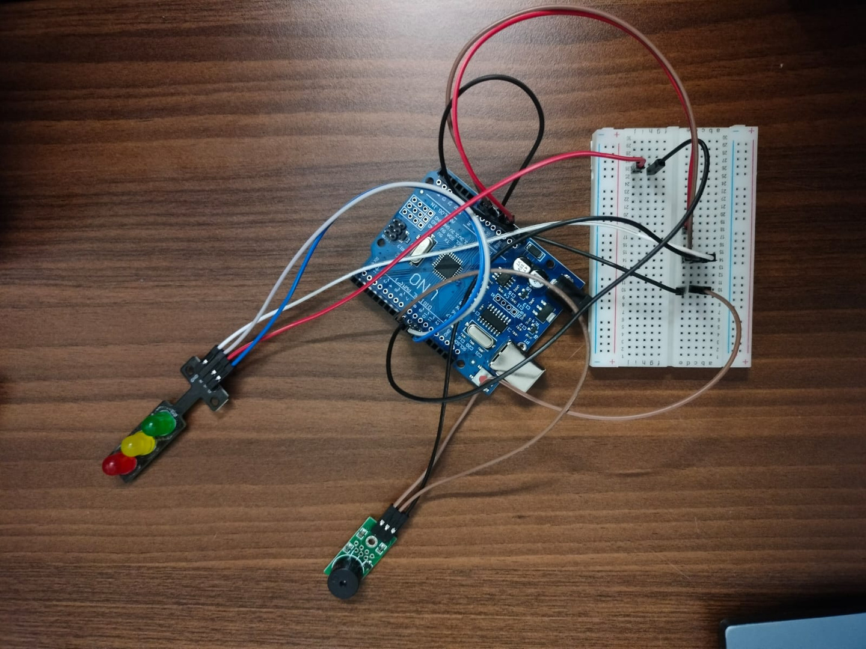
Hardware Setup

Slide 6


System Overview
Face Detection
Eye +
Mouth Landmark Detection
Webcam
Arduino (LED/Buzzer)
Multi-level Alert
EAR & Yawn Ratio

Slide 7
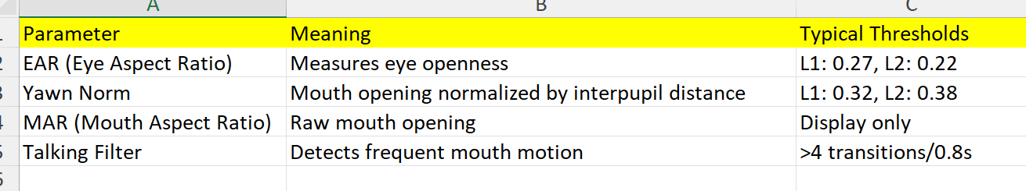
Detection Parameters

Slide 8
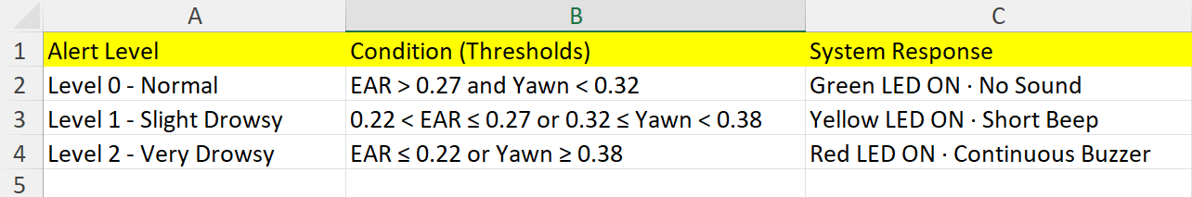
Multi-Level Alert System
  The system classifies driver alertness into three stages based on the Eye Aspect Ratio (EAR) and Normalized Yawn Metric (NYM).
  Each level activates a distinct visual and sound alert through Arduino to warn the driver before critical fatigue occurs.

Slide 9
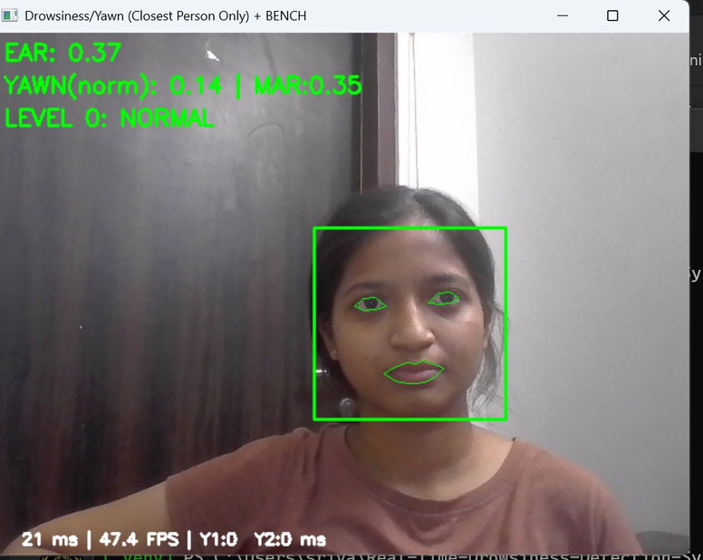
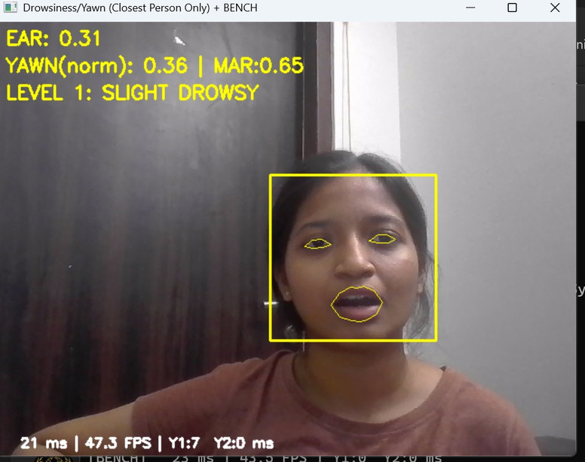
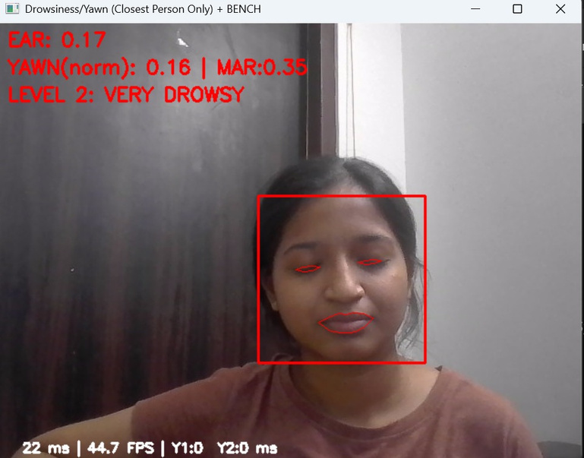
Images
Eyes

Slide 10
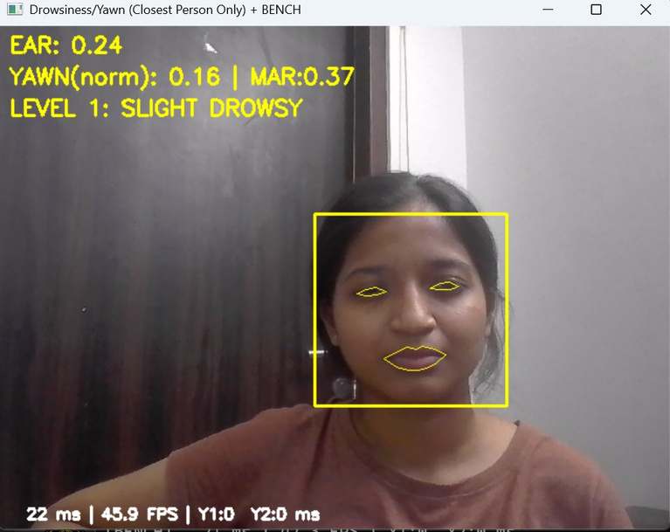
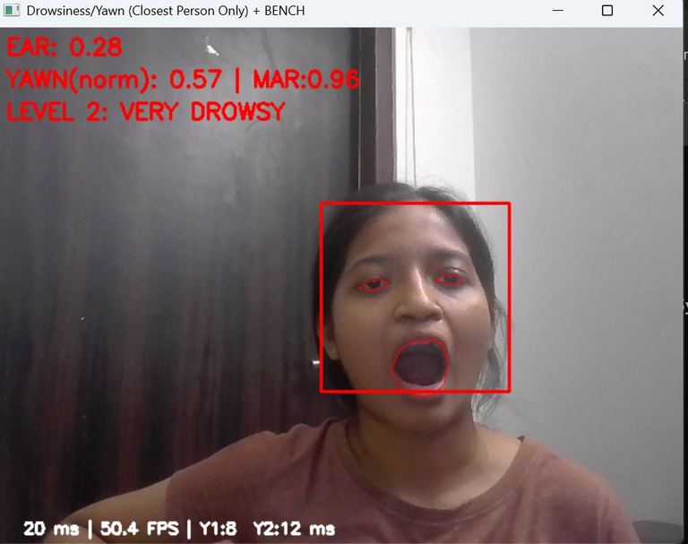
Images
Yawn

Slide 11
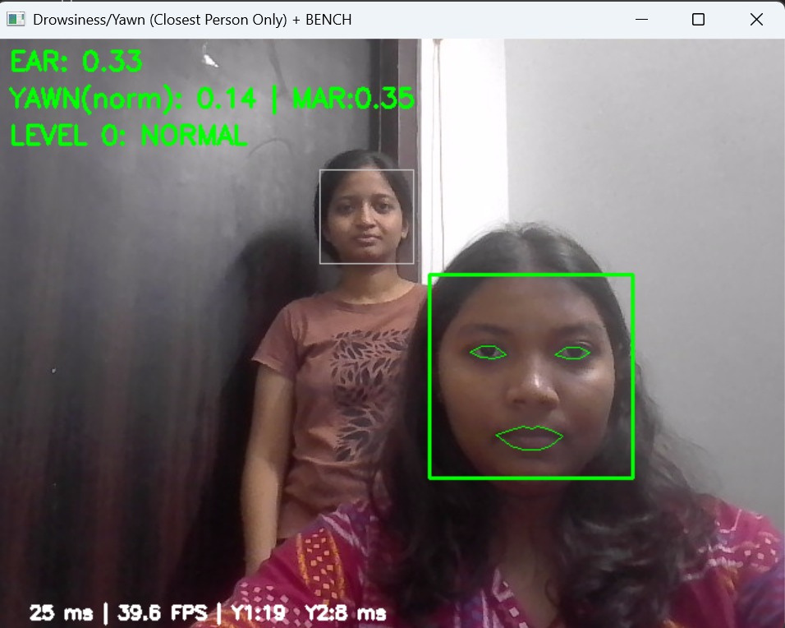
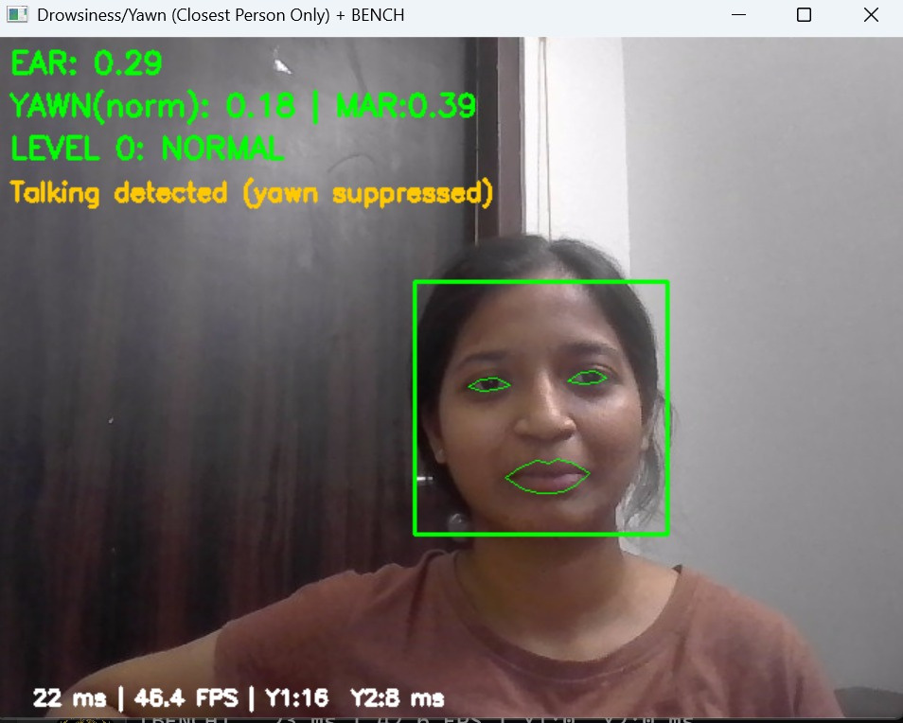
Additional Features
System automatically identifies and tracks only the closest person to the camera for accurate drowsiness detection.
Talking detection feature prevents false yawning alerts by recognizing mouth movement patterns during speech.

Slide 12
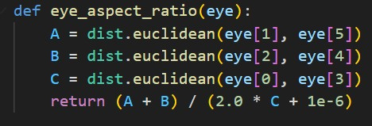
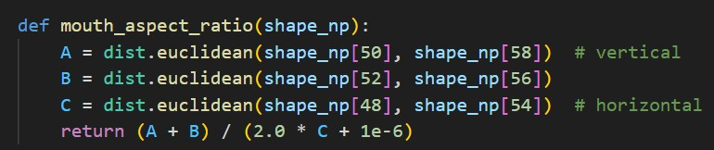
Code Snippets
Eye Aspect Ratio (EAR):
This function calculates the ratio between vertical and horizontal distances of eye landmarks to measure eye openness.
A low EAR value indicates the eyes are closing or blinking, helping detect drowsiness.
Mouth Aspect Ratio (MAR):
This function computes the ratio between vertical and horizontal distances of mouth landmarks.
A high MAR value indicates the mouth is widely open — used for yawn detection.

Slide 13
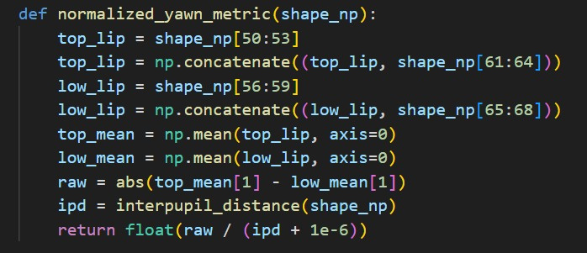
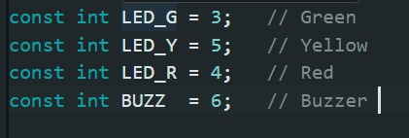
Code Snippets
This function measures how wide the mouth opens by comparing upper and lower lip positions.
It normalizes the value by interpupil distance so yawns are detected reliably at any face size or camera distance.
This block assigns specific Arduino pins to each LED and the buzzer, so the system can visually and audibly represent Normal, Warning, and Critical drowsiness states.

Slide 14
Limitations and Future Scope
  Sunglasses or masks obstruct face/eyes.
  Poor lighting or camera angle affects accuracy
  Limited to single person (closest face).
  Not suitable for night driving without IR came
  Mobile app or cloud-based alert logging
  Adaptive Illumination System: Automatic brightness and in varying lighting conditions — e.g., when a vehicle enters a tunnel — ensuring reliable detection even in low light.

Slide 15

THANK YOU!

